Slide 1




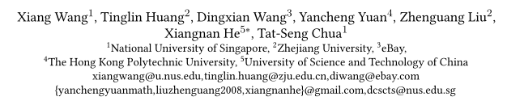

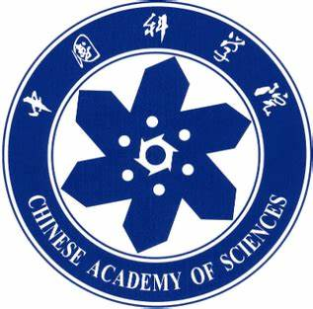

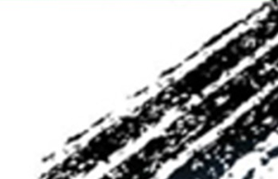

Chongqing University of Technology
ATAI
Advanced Technique of Artificial Intelligence
Chongqing University of Technology
Learning Intents behind Interactions with Knowledge Graph for Recommendation（WWW 2021 ）
陶佳

Slide 2
Content
Introduction
Method
Experiment

Slide 3
Introduction
End-to-end models founded on graph neural networks (GNNs) . The key idea is to utilize the information aggregation scheme, which can effectively integrate multi-hop neighbors into representations. Benefiting from the integration of connectivity modeling and representation learning, these GNN-based models achieve promising performance for recommendation.

Slide 4
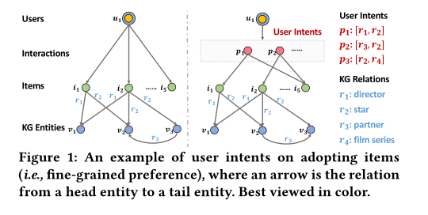
Introduction
GNN-based methods fall short in modeling two factors:
(1) User Intents. To the best of our knowledge, none of these studies consider user-item relations at a finer-grained level of intents. An important fact has been ignored: a user typically has multiple intents, driving the user to consume different items

Slide 5
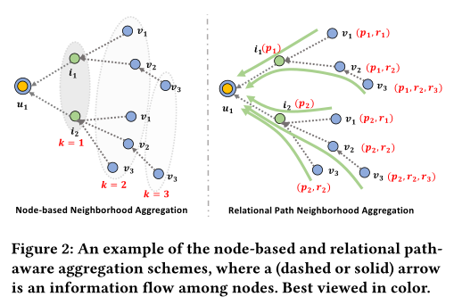
Introduction
(2)Relational Paths. In these studies, the information aggregation schemes are mostly node-based — that is, to collect the information from neighboring nodes, without differentiating which paths it comes from.

Slide 6
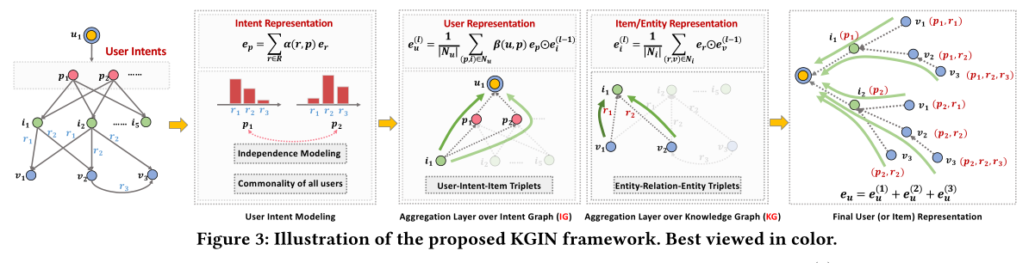
Method

Slide 7
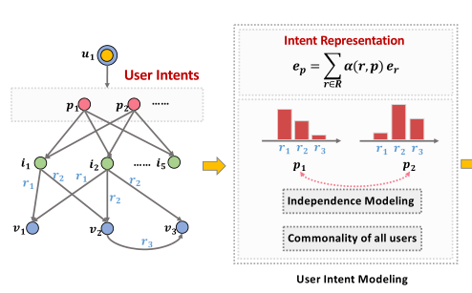
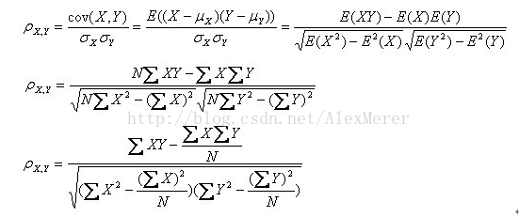
User Intent Modeling
Representation Learning of Intents
Independence Modeling of Intents
Notes:
$$α=1$$

Slide 8
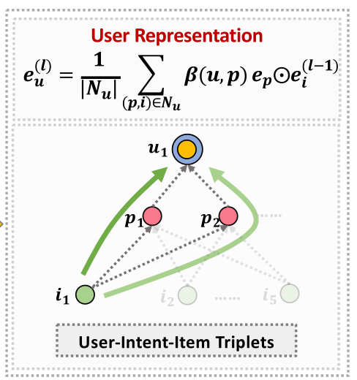
Relational Path-aware Aggregation
Aggregation Layer over Intent Graph
Notes:
$$α=1$$

Slide 9
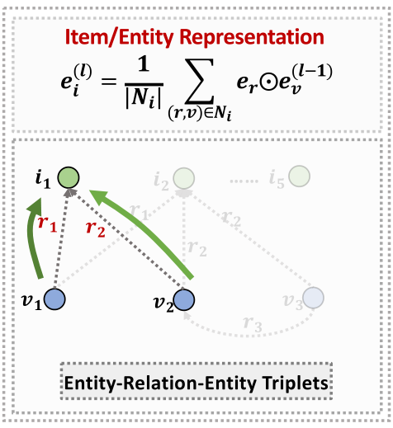
Relational Path-aware Aggregation
Aggregation Layer over Knowledge Graph
Notes:
$$α=1$$

Slide 10
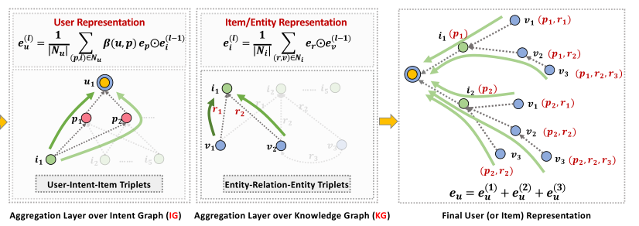
Relational Path-aware Aggregation
Capturing Relational Paths
Notes:
$$α=1$$

Slide 11
Model Prediction and Optimization
Notes:
$$α=1$$

Slide 12
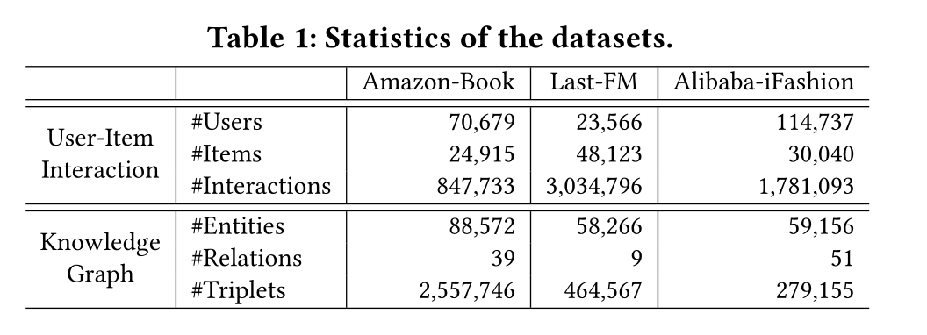
Experiment

Slide 13
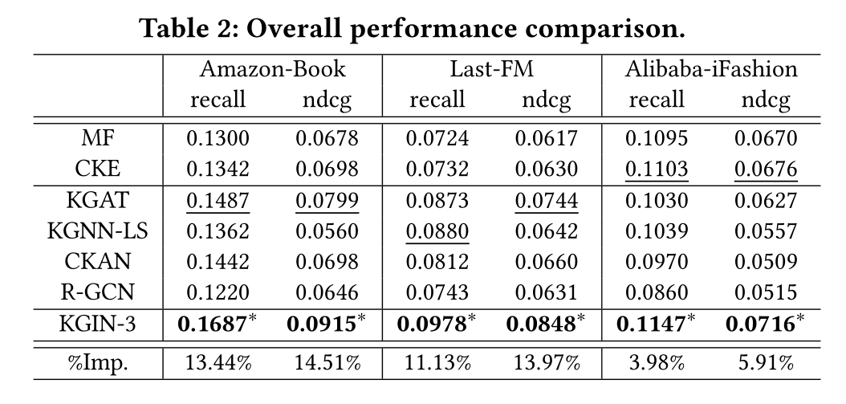
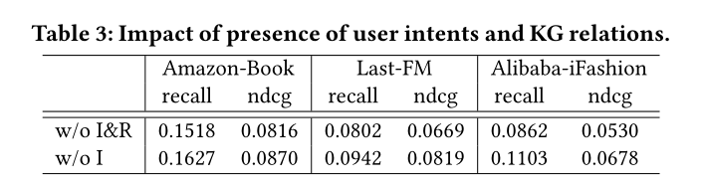
Experiment

Slide 14
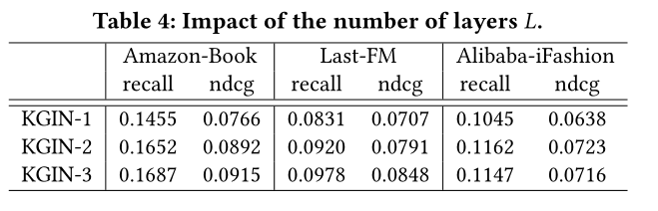
Experiment

Slide 15
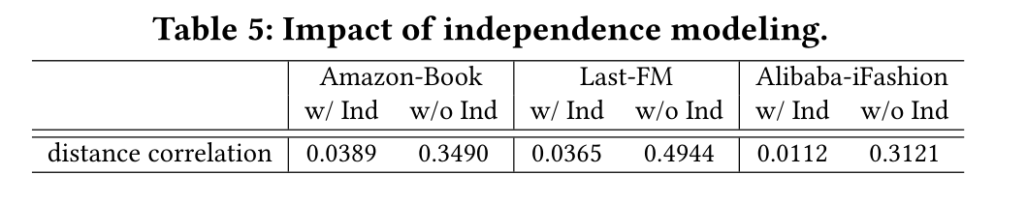
Experiment

Slide 16
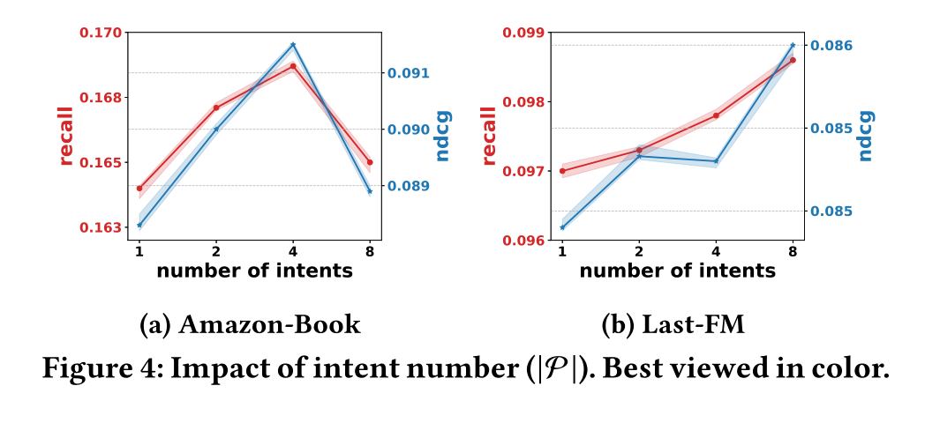
Experiment

Slide 17
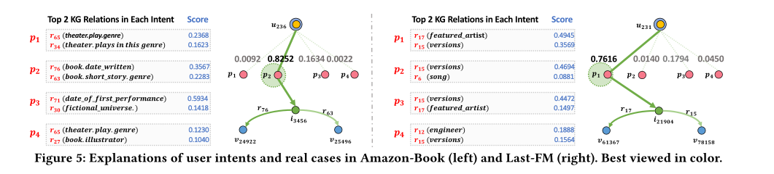
Experiment

Slide 18
Thanks

